Slide 1

Problem Statement
Falsified News Detection
Using Deep Learning Approach
Group No. 23:
Ghanshyam Patil
Ketan Patel
Piyush Pawar
Sudesh Pawar
Guided By:
Prof. S.P. Khedkar
Prof. B.F. More

Slide 2
Motivation
In Today's world, anybody can post the content over the internet.
It is harmful for the society to believe on the rumors and pretend to be a news.
The fake news can lead to mob lynching, riots and negative or wrong information
Fake news detection is made to stop the rumors that are being spread through the various platforms whether it be social media or messaging platforms
Fake news tries to stop such false information thereby protecting the society from this kind of violence.
Satirical Cues are prevalent in false news & they can help in detection.

Slide 3
Objectives
Most of the smart phone users prefer to read the news via social media over internet.
Lots of Falsified news is being circulated on social media
The need of an hour is to stop the rumors and focus on the correct, authenticated news articles.
The question is how to authenticate the difference.
The main objective with this project is to classify the news into fake or real
With the help of Deep Learning and Neural Networks we can classify it.

Slide 4
Applications
For accreditation of authenticity of media houses.
Users can verify news correctness.
In Forensic Investigation of Cases.
In Systems designed to stop spreading of Misinformation

Slide 5
Literature Review (1/2)
No | Title | Publisher | Outcomes
1 | Fake News Detection using Deep Learning (2020) | IEEE | We have understood how vectorization can help in better classification & formed basic idea of model.
2 | A Multi-semantics Classification Method Based on Deep Learning for In-credible Messages on Social Media (2019) | CJE (Scopus-Indexed) | Used as reference to deal with emotional semantic features.
3 | Detecting Misleading Information on COVID-19 (2020) | IEEE | Understood how deep learning models can be ensembled together.
4 | Fake News Stance Detection Using Deep Learning Architecture. (2020) | IEEE | How PCA can help in dimensionality reduction.
5 | Big Data and quality data for fake news and misinformation detection (2020) | Big Data Society (Scopus-Indexed) | How Data should be treated further for better classification.

Slide 6
Literature Review (2/2)
No | Title | Publisher | Outcomes
6 | FakeDetector: Effective Fake News Detection with Deep Diffusive Neural Network. (2020) | Arxiv | How Fusioning between the layers and tweaking hyperparameters helps classifying.
7 | Fake news detection using deep learning models: A novel approach (2020) | TETT | Understood how deep learning models can be ensembled together with attention mechanism.
8 | Fake News Detection: A Deep Learning Approach (2018) | SMU Journal on Data Science | How Stance of a News can affect whether it is fake or True was understood.
9 | FNDNet – A deep convolutional neural network for fake news detection (2020) | Springer | How NN can learn discriminatory features of the underlying textual data.
10 | Deep Learning Algorithms for Detecting Fake News in Online Text | ICCES (IEEE) | Comparison between Gated Recurrent Unit and Neural Networks were understood.

Slide 7
Algorithm (1/2) – NLP Phase
N-gram model is contiguous sequence of n items from a sample of text and widely used tool in language processing. It estimates from preceding words, compute the probability by counting in corpus and normalizing to a sentence/ any other sequence of words.
TF-IDF is a short for term frequency in information retrieval. It is a statistic that reflect the importance of a word in the document. It helps to increase the proportional where a word appears in number of times and adjust for the fact that some word that exists consistently in general.
Stopword Removal is also performed along with the above 2 methods to reduce the effect of unnecessary words contributing to the classification.

Slide 8
Algorithm (2/2) – Neural Network
With all the pre-processed new titles and content in vectors form, Keras neural network models with some dense layers are built and trained using Tensorflow framework to perform classification task of detecting the fake news.
In the Keras neural network model, the layers 1, 3 and 5 are using RELU as the activation function with 32 nodes, 16 nodes and 8 nodes respectively.
In between these 3 layers, 2 dropout layers of 40% dropout rate are also added to the network. The purpose of adding dropout layers is used to avoid from overfitting by dropping some node and therefore, generalize better.
Then, the last layer of the Keras neural network model, also known as output layer, is added with sigmoid activation function so to ensure the output of the network is in binary format because there are only 2 possible outcomes from this project such that “0” refers to real news and “1” refers to fake news.

Slide 9
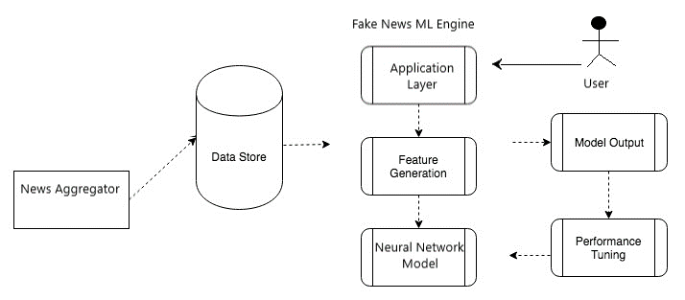
System Architecture

Slide 10






Tech Stack Used

Slide 11
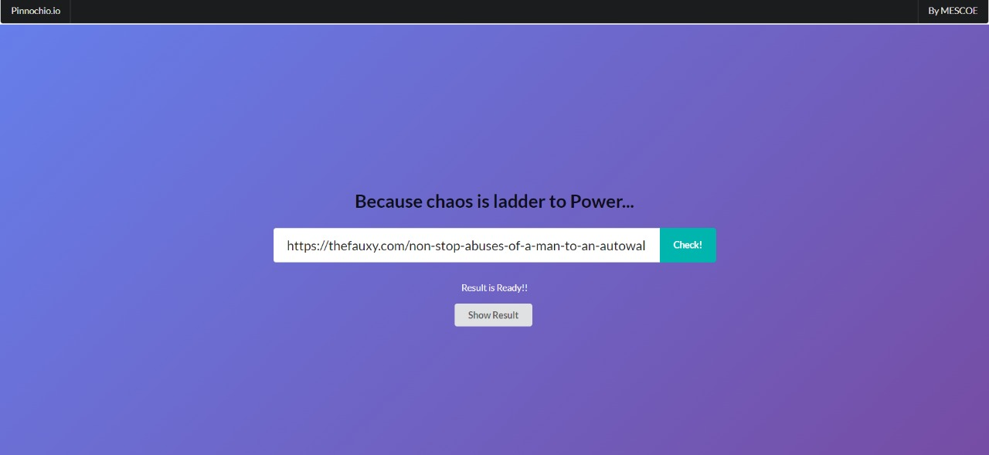
Implementation
A) Home Page (React)

Slide 12
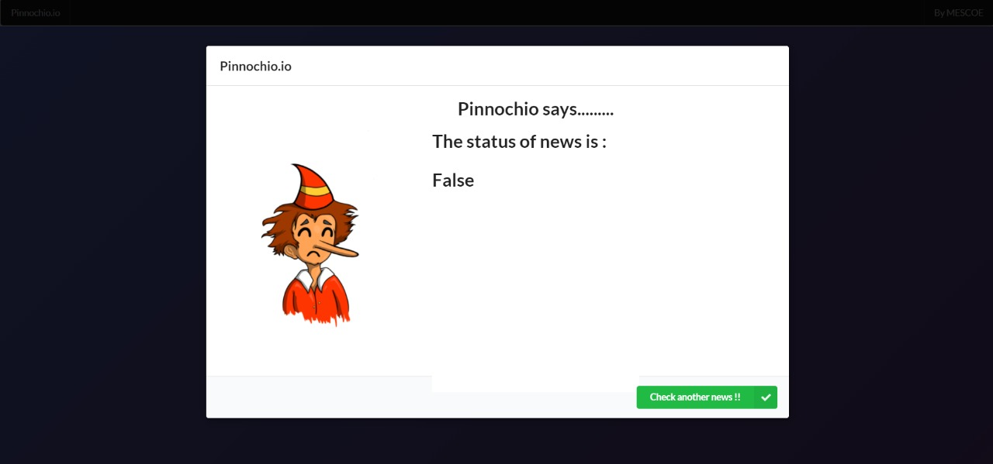
Implementation
B) Instance of a Fake News

Slide 13
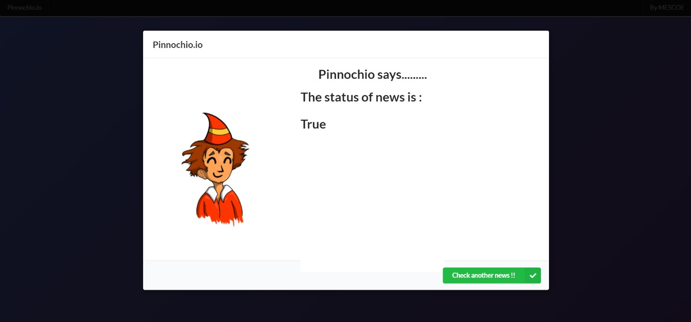
Implementation
C) Instance of a Real News

Slide 14
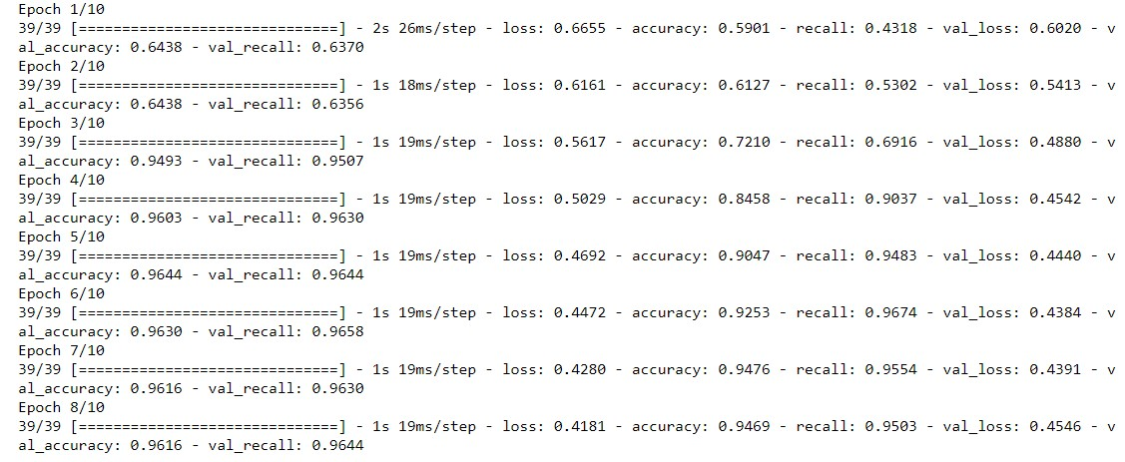
Implementation
D) Backend Model Training

Slide 15
Testing
Type of Testing | Comments
Unit Testing | All Individual Units were tested separately. Unit Test was declared successful.
Integration Testing | The NLP and Deep Learning Model, Flask Server, React Frontend and Processing modules are integrated and tested as a single complete web application to verify that it works as expected.
System Testing | The System was tested to check whether it is working as intended and the test was successful.
Compatibility Testing | The Web App was deployed on various OS and tested using different Browsers. Test was successful.
GUI Testing | All React Components were tested for any structural misalignment. GUI was working as Intended.
Stress Testing | The Local Deployment was found to be system dependent. To overcome this, Cloud Deployment on Heroku was implemented.

Slide 16
Testing
No. | Type | Test Data | Expected Result | Observed Result | Status
TC1 | Satire | https://thefauxy.com/man-dies-after-taking-pakvac-imran-khan-claims-vaccine-working-perfectly-fine-since-corona-virus-also-died-inside-mans-body/ | FAKE | FAKE | PASS
TC2 | Real News | https://indianexpress.com/article/india/coronavirus-india-live-updates-lockdown-news-india-covid-vaccine-7353818/ | TRUE | TRUE | PASS
TC3 | Fake News | https://www.vice.com/en/article/epndea/florida-gop-made-it-harder-to-vote-after-bragging-about-the-2020-election | FAKE | FAKE | PASS
TC4 | Media | https://www.youtube.com/c/DannyMullenOfficial | INVALID | INVALID | PASS
TC5 | Invalid URL | ww.theonioncom/fbi-says-chauvin-matches-prole-of-blue-uniformed-kill-1846732261 | INVALID | INVALID | PASS

Slide 17
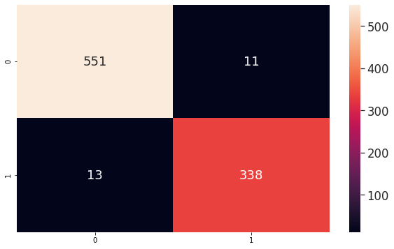
Results – Confusion Matrix
The Trained Model was subjected to an unknown data consisting of 913 Articles. The Confusion Matrix for the same is as above.

Slide 18
Results – Comparison of Algorithms
Algorithm | Accuracy | F1- Score
NLP + SVM | 91.09 | 86.77
NLP + Decision Tree | 93.83 | 88.93
NLP + LR | 89.67 | 84.42
NLP + Deep Learning (NN) | 94.69 | 91.74

Slide 19
Conclusion
Many people consume news from social network instead of main-stream news media. However, social media has also been used to spread misinformation, which has bad impact on individuals and communities.
In this project, a model for falsified news detection using deep learning algorithm & N-Gram Vectorization has been developed.
This model takes news URL/Title as an input and based on the features observed by deep learning model, it predicts whether news is false or true and displays it to the user via a web app interface.

Slide 20
Future Work
Since the entire project has been developed using design patterns which emphasize on modularity of the individual components, we have managed to develop the backend in such a form that it can be used by any website/application without any issues.
The Backend accepts URL of articles in JSON format and returns the result in JSON , making the entire backend as lucid as a REST API.
Therefore, we believe that there is a great scope of application of our model in a lot of applications.
The Model can be further optimized once GPT-3 is publicly available for use.
Graph based Neural Networks can also be looked towards as one of the options.

Slide 21
Paper Publication Status -1
Title : A Review on Falsified News Detection Using Deep Learning Approach
Journal : IJRASET
Status : Accepted with Revisions
DOI : https://doi.org/10.22214/ijraset.2021.34526

Slide 22
Paper Publication Status -2
Title : Falsified News Detection Using Deep Learning Approach
Paper ID : 840
Conference : IEEE ASIANCON-2021
Status : Submitted, Acceptance will be updated by July 2 2021

Slide 23
References (1/2)
[1] S. H. Kong, L. M. Tan, K. H. Gan and N. H. Samsudin, ” Fake News Detection using Deep Learning,” 2020 IEEE 10th Symposium on Computer Applications Industrial Electronics (ISCAIE),Malaysia, 2020, pp. 102-107, doi: 10.1109/ISCAIE47305.2020.9108841..
[2] L. Wu, Y. Rao, H. Yu, Y. Wang and N. Ambreen, ”A Multi-semantics Classification Method Based on Deep Learning for In-credible Messages on Social Media,” in Chinese Journal of Electronics, vol. 28, no. 4, pp. 754-763, 7 2019, doi: 10.1049/cje.2019.05.002.
[3] M. K. Elhadad, K. F. Li and F. Gebali, ”Detecting Misleading Information on COVID-19,” in IEEE Access, vol. 8, pp. 165201-165215, 2020, doi: 10.1109/ACCESS.2020.3022867.
[4] M. Umer, Z. Imtiaz, S. Ullah, A. Mehmood, G. S. Choi and B.W. On, ”Fake News Stance Detection Using Deep Learning Architecture (CNN-LSTM),” in IEEE Access, vol. 8, pp. 156695-156706, 2020, doi: 10.1109/ACCESS.2020.3019735.
[5] F. T. Asr and M. Taboada, ”Big Data and quality data for fakenews and misinformation detection”, Big Data Soc., vol. 6, no. 1,pp. 1-14, May 2019.
[6] Jiawei, Zhang Dong, Bowen & Yu, Philip. (2020). FakeDetector: Effective Fake News Detection with Deep Diffusive Neural Network. 1826-1829. 10.1109/ICDE48307.2020.00180.
[7] Kumar, S, Asthana, R, Upadhyay, S, Upreti, N, Akbar, M. Fake news detection using deep learning models: A novel approach. Trans Emerging Tel Tech. 2020; 31:e3767.
[8] Thota, Aswini; Tilak, Priyanka; Ahluwalia, Simrat; and Lohia, Nibrat (2018) "Fake News Detection: A Deep Learning Approach," SMU Data Science Review: Vol. 1 : No. 3 , Article 10.

Slide 24
References (2/2)
[9] R. K.Kaliyar, A.Goswami, P.Narang, S. Sinha, FNDNet – A deep convolutional neural network for fake news detection, Cognitive Systems Research,Vol. 61, 2020,Pg 32-44, ISSN 1389-0417.
[10] S. Girgis, E. Amer and M. Gadallah, "Deep Learning Algorithms for Detecting Fake News in Online Text," 2018 13th Intl Conference on Computer Engineering and Systems (ICCES), 2018, pp. 93-97, doi: 10.1109/ICCES.2018.8639198.
[11] Agarwal, A., Mittal, M., Pathak, A. et al. Fake News Detection Using a Blend of Neural Networks: An Application of Deep Learning. SN COMPUT. SCI. 1, 143 (2020).

